Slide 1


Eduembed :
Embedding for Education
Project Review - 3
Under Supervision Of:
Prof. Srinath Srinivas
Anurag Mohanty
By:
Sheetal Agarwal (MT2022109)
Sahil Khatri (MT2022095)

Slide 2
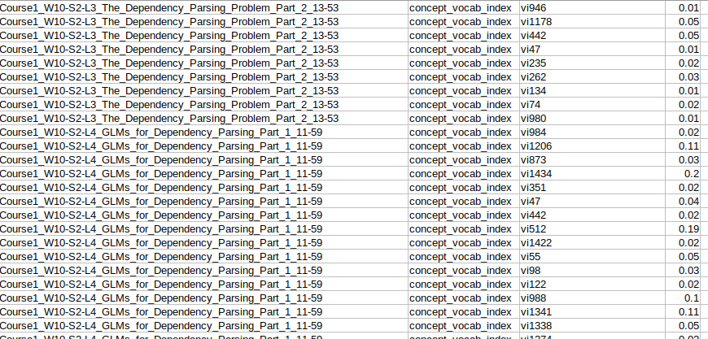
Concept-Vocab with weights using Tf-Idf
(Preprocessing and data formation)

Slide 3
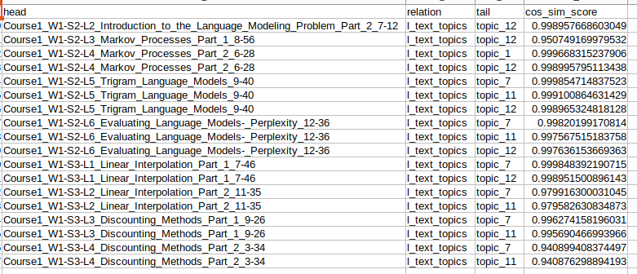
TransH cosine similarity
(Head + Relation=Tail)

Slide 4
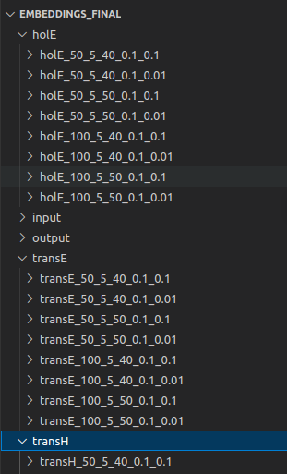
Directory Structure
Automated workflow to train multiple models with
variations of Hyperparameters.
transH_50_5_50_0.1_0.1
modelName
epochs
Batchescount
Embeddingsize
Structuralweight
learningrate

Slide 5
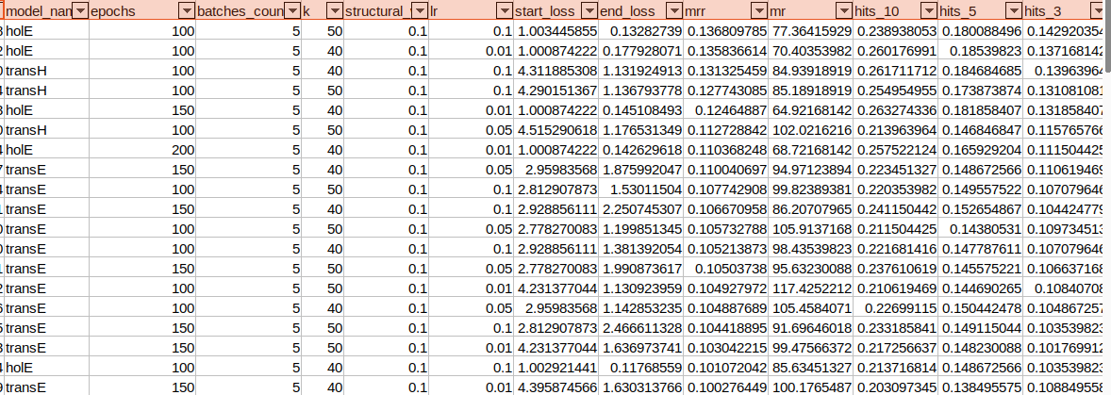
Hyperparameter Evaluation Metric

Slide 6
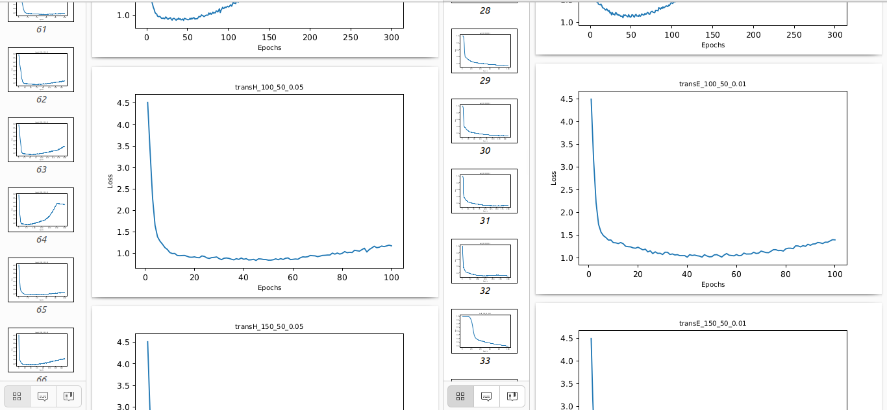
Loss Evaluation for TransE, TransH, HolE

Slide 7
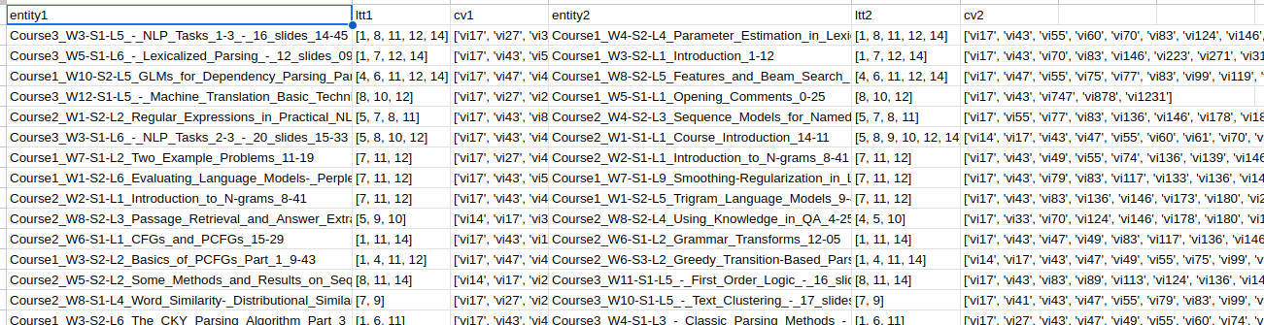
Data Preparation for Qualitative Analysis

Slide 8
Cosine Similarity Evaluation
Entity and Entity similarity
Head+Relation and Tail similarity
Entity1(Head+Relation) and Entity2 (Head+Relation) for l_text_topics relation
Entity1(Head+Relation) and Entity2 (Head+Relation) for concept_vocab_index relation

Slide 9
THANK YOU

